Slide 1
WEEK 1

Slide 2
Programming languages
A language is a medium for communication
Programming languages communicate computational instructions
Translate high level language to low level language
Java
Binary language(0’s and 1’s)
Compilers and Interpreters

Slide 3
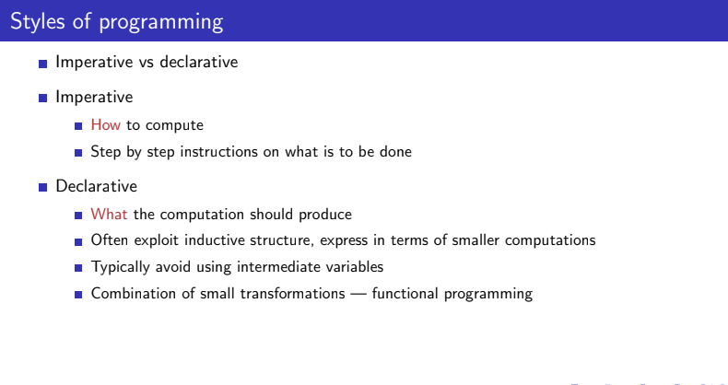

Slide 4
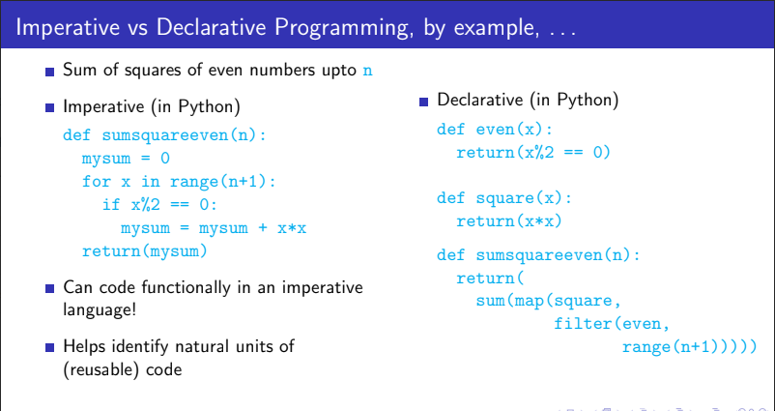

Slide 5
Names,values,types
Variables
int n=23;
23
n

Slide 6
Scope of variable
The part of the program in which the variable can be accessed.
Lifetime of variable
It indicates how long the variable stays alive in the memory.

Slide 7
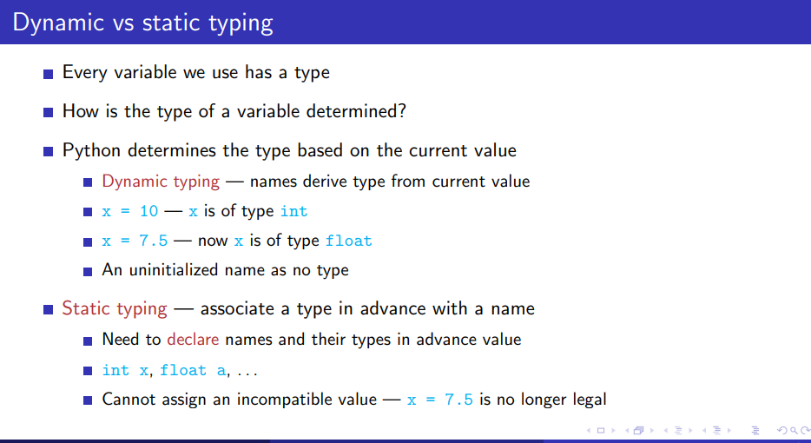

Slide 8
Collections,Abstract data types
Collections like array,list etc..
Abstract data types
Stack ADT,Queue ADT etc
Structured collection with fixed interface
Stack is a sequence, but only allows push and pop
Separate implementation from interface
2
3
4
6

Slide 9
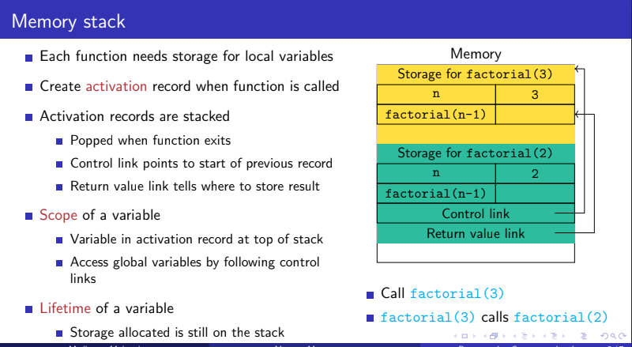

Slide 10
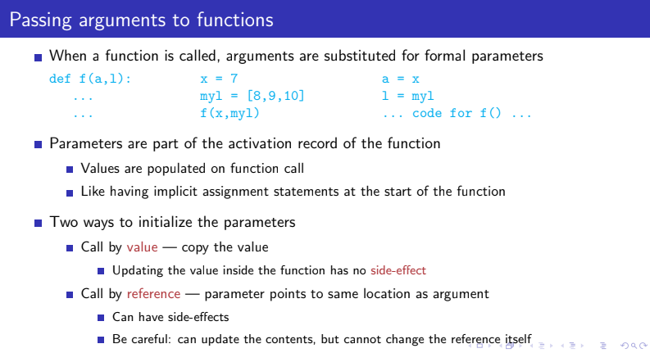

Slide 11
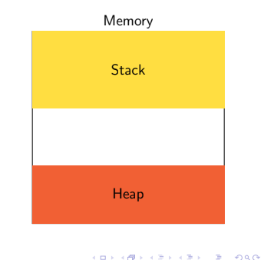

Slide 12
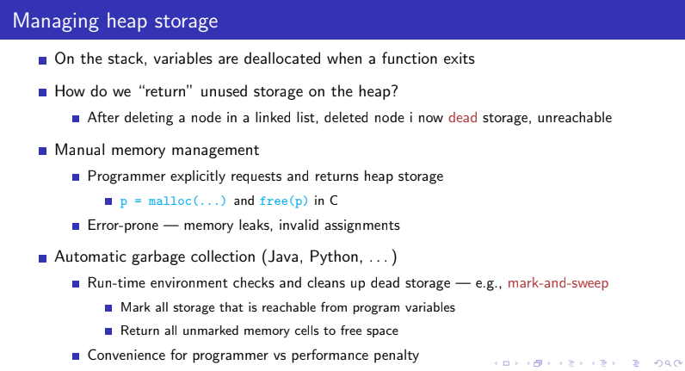

Slide 13
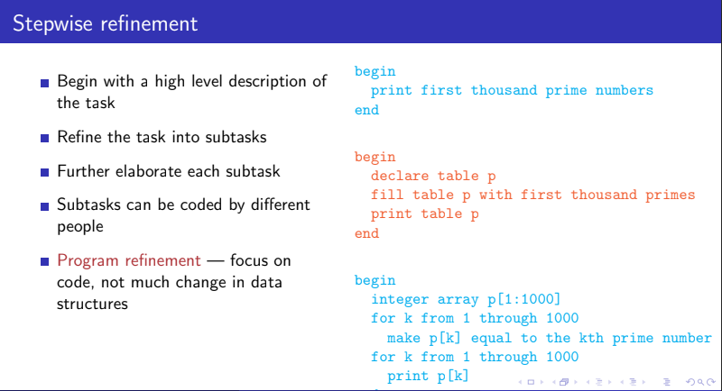

Slide 14
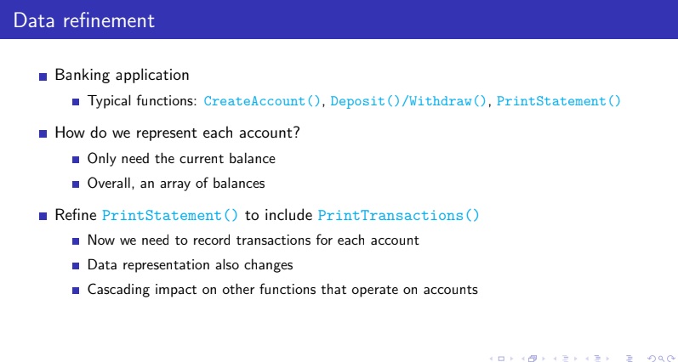

Slide 15
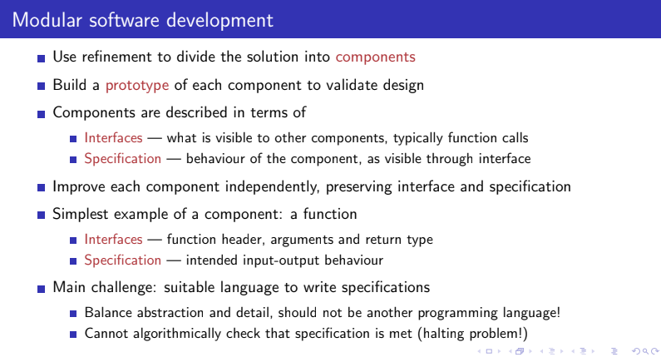

Slide 16
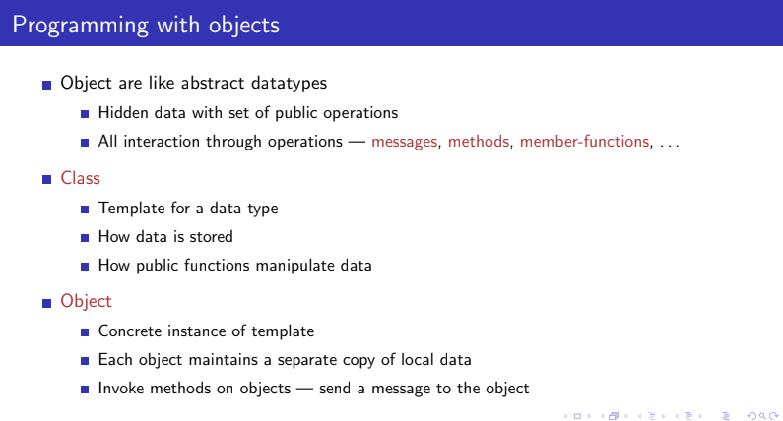

Slide 17
Car
class Car:
def __init__(self,brand,color) :
self.brand=brand
self.color=color
def drive(self):
print('driving')
c1=Car('Ford','White')
print(c.brand)
print(c.color)
c2=Car('Bmw','Red')
print(c.brand)
print(c.color)
Brand
Color
drive()
Class
c1
c2
Ford
White
drive()
Bmw
Red
drive()
Object

Slide 18
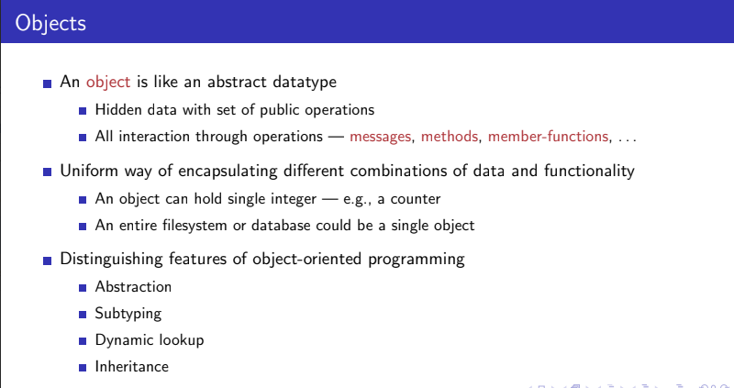

Slide 19
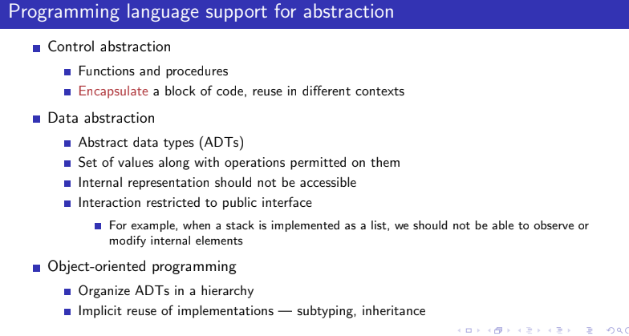

Slide 20
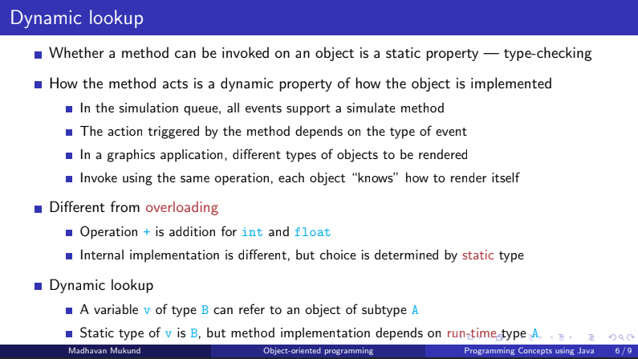

Slide 21
Subtyping
A subtype is a specialization of a type
If A is a subtype of B, wherever an object of type B is needed, an object of type A can be used.
Every object of type A is also an object of type B
Think subset — if X ⊆ Y , every x ∈ X is also in Y
If f() is a method in B and A is a subtype of B, every object of A also supports f().
Implementation of f() can be different in A.
Dequeue is subtype of stack,queue

Slide 22
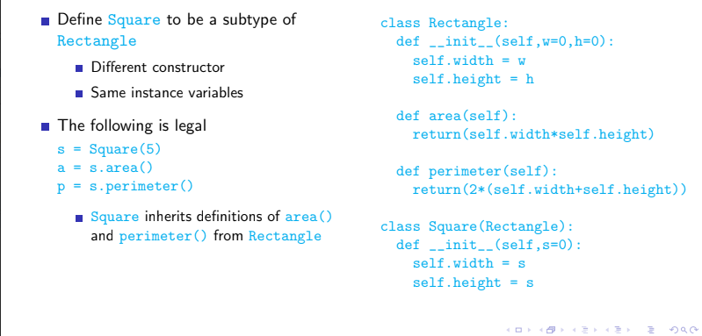

Slide 23
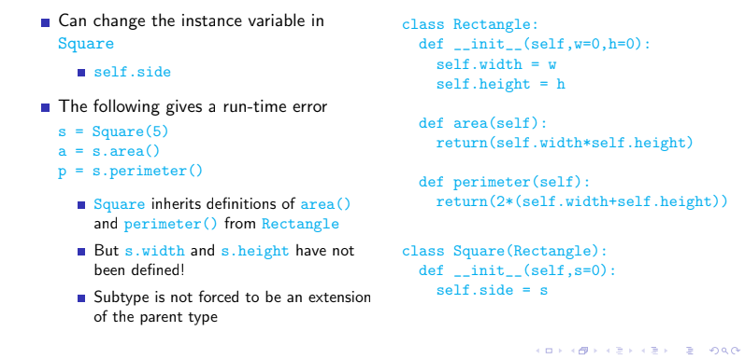

Slide 24
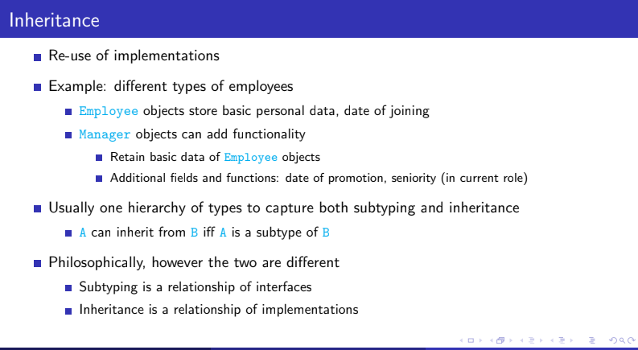

Slide 25
